Slide 1





Predictive analytics S&P 500 sector returns vs economic indicators
Holly shirmenzagas, Daniel Jackson, Nathan palmer, Daniel ”DC” Carrillo

Slide 2




We looked at s&p 500 sector data
Consumer Discretionary Consumer Staples Energy Financial Health Industrial Energy Materials Technology Utilities

Slide 3




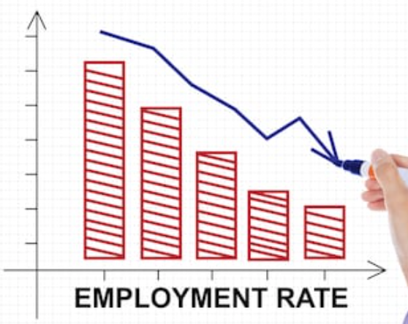
We looked at specific economic indicators
Typical Economic Indicators Unemployment Import/Export Index Consumer Price Index Producer Price Index
Atypical Economic Indicators Cardboard pricing Superbowl AFC/NFC Beer pricing Cosmetics prices Crime scene investigation Underwear prices Haircut pricing

Slide 4
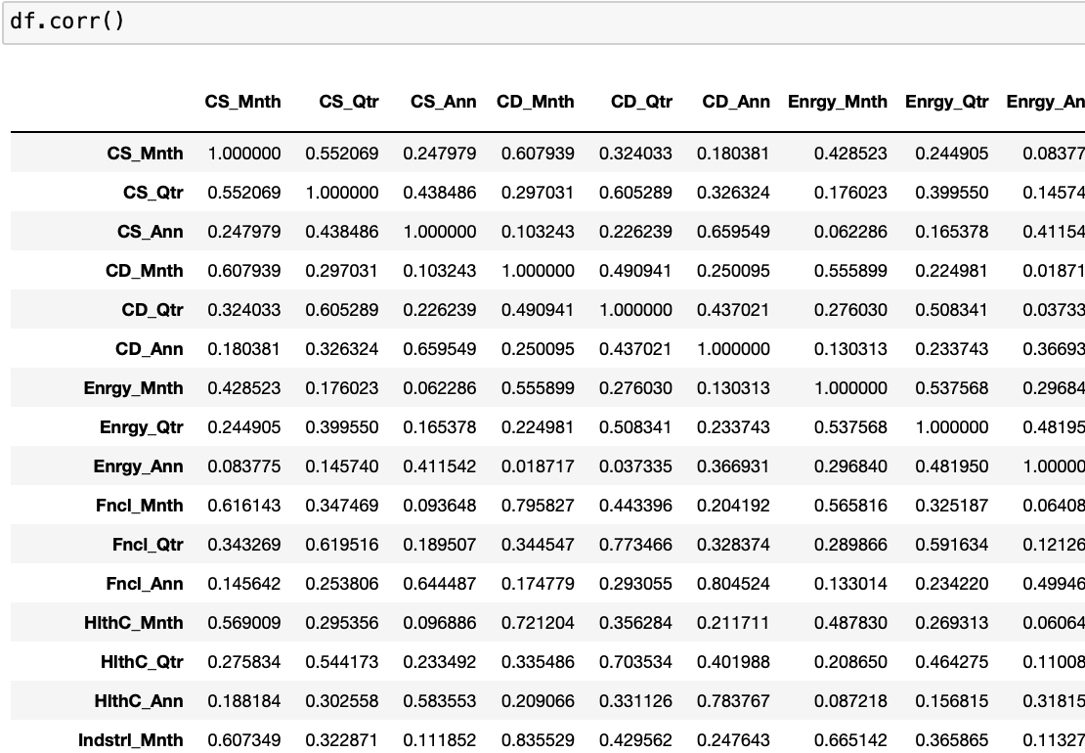
Initial linear regression models
We used a very simple approach for initial visualizations of the data with linear regression
We specifically observed correlations of our data sets as a cursory overview

Slide 5
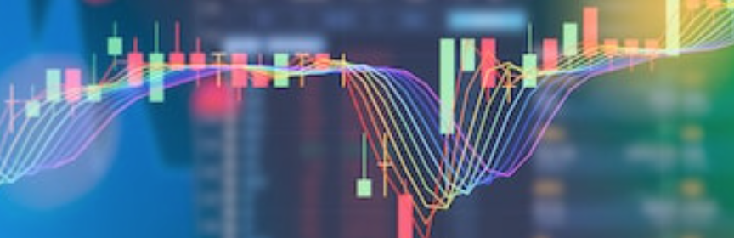
empowered predictive analysis with skylearn

Slide 6
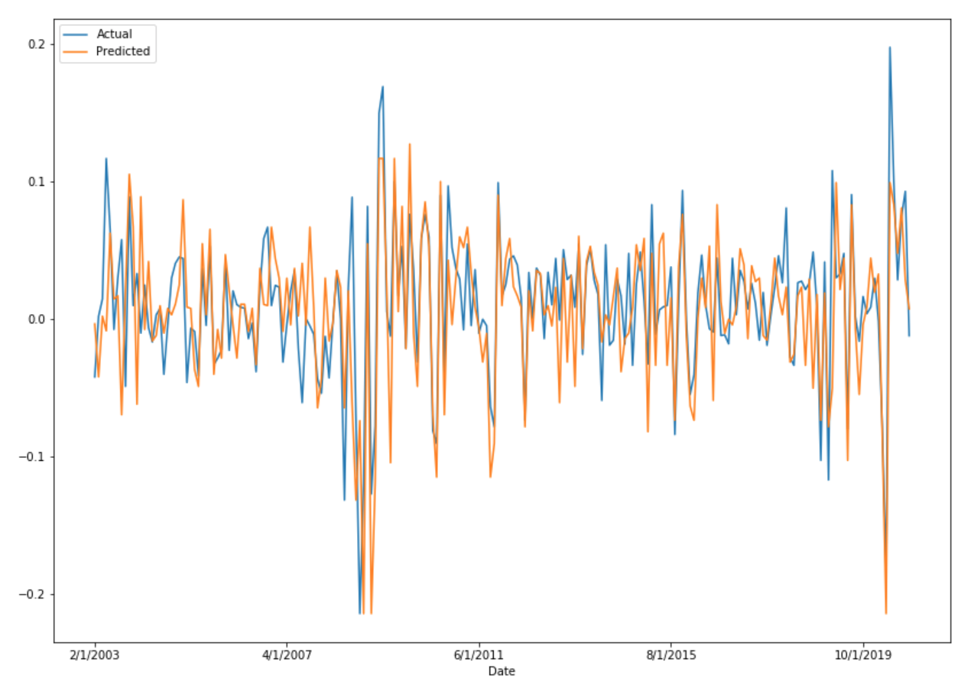
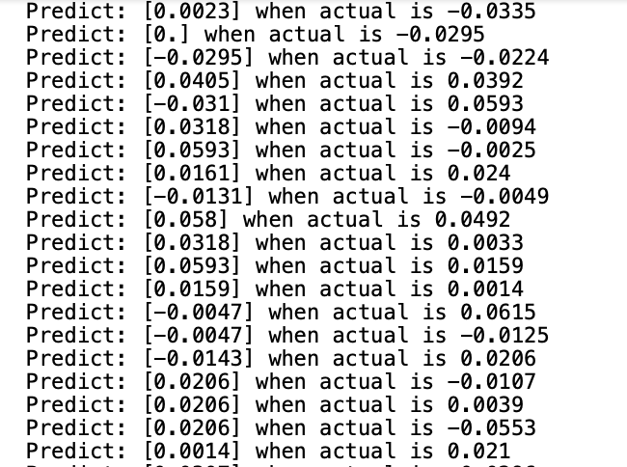
Algorithm & backtesting
Predictive data generated with Skylearn
Predictive data visualized with Matplotlib

Slide 7


Slide 8
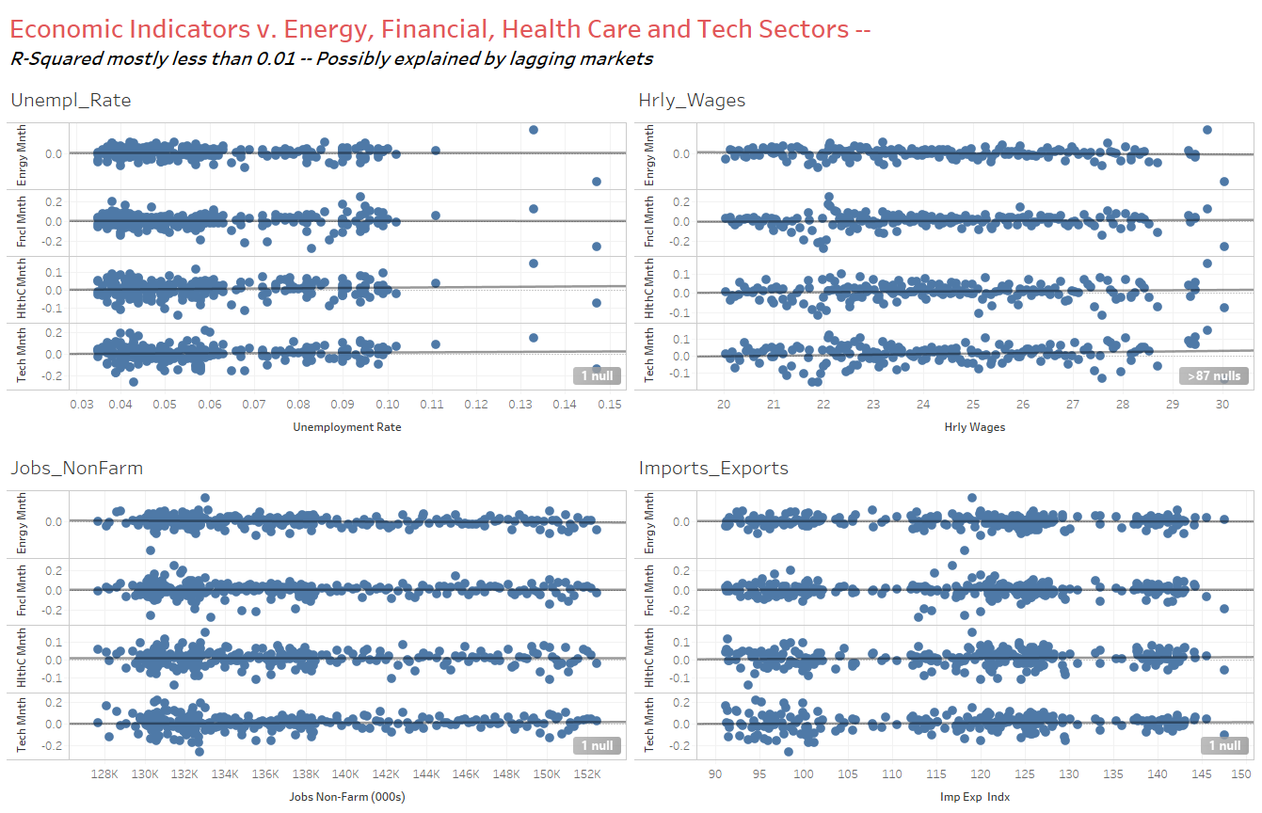
Economic Indicators vs. energy, financial, health care & tech
* Input analysis *

Slide 9
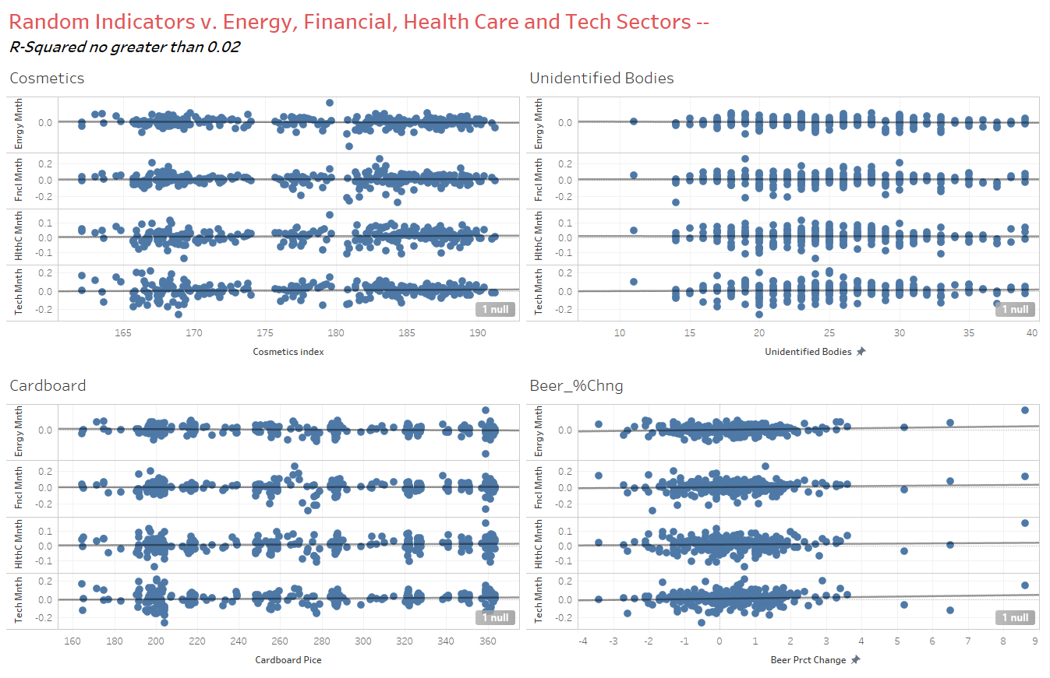
Random indicators vs. Energy, Financial, health care & tech
* Input analysis *

Slide 10
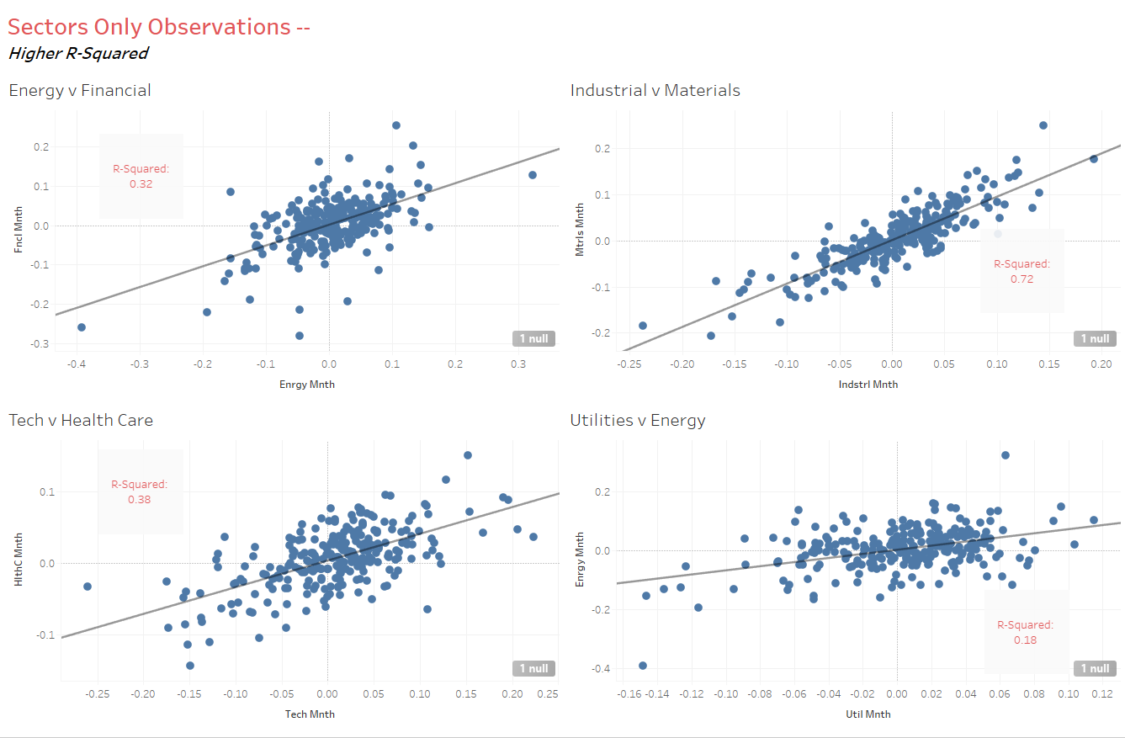
Sectors only observations
* Input analysis *

Slide 11
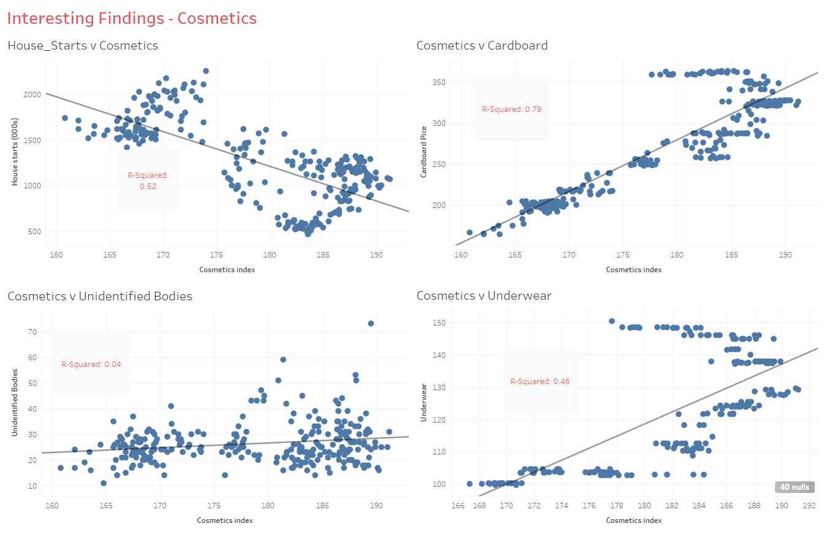
Interesting findings - cosmetics
* Input analysis *

Slide 12
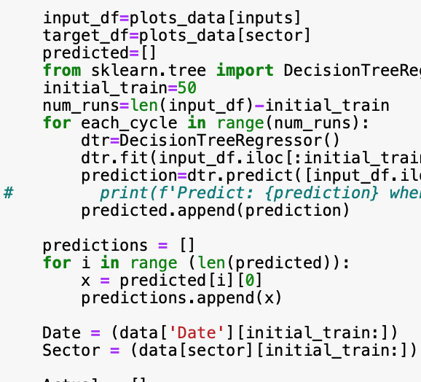
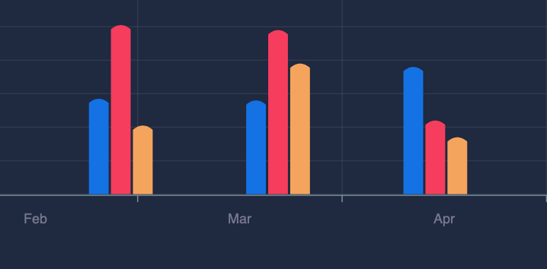
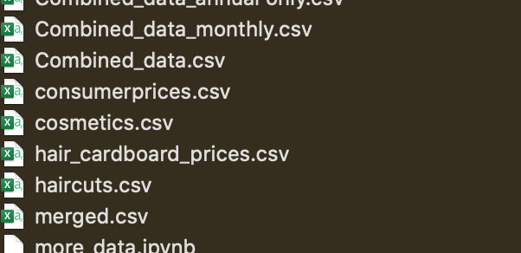
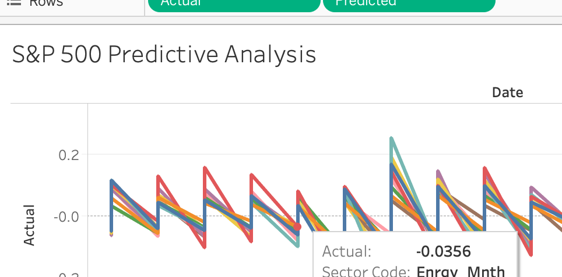
The process

Slide 13

to be continued…

